Slide 1
Muhammad Taaha Hashmi
Ameer Hamza
Abdussalam Sarmad
Driver Drowsiness Monitoring System
The Fatal Impact
The "Silent Killer"
Road traffic crashes tragically claim approximately 1.19 million lives globally every year (WHO, 2024). This staggering figure highlights the urgent need for enhanced road safety measures.
Drowsy driving is a primary factor in 100,000 police-reported crashes annually. Recent 2024 studies estimate that nearly 17.6% of all fatal crashes involve a sleep-deprived driver, making it a significant, yet often overlooked, danger.
The 20-Hour Rule
Economic Toll
Driving after 20 hours without sleep is cognitively equivalent to driving with a Blood Alcohol Concentration (BAC) of 0.08%—the legal limit for intoxication in many countries. This underscores the profound impairment caused by fatigue.
Fatigue-related accidents impose an immense financial burden, resulting in over $109 billion in societal costs annually. This includes healthcare expenses, lost productivity, and extensive property damage.
Our project aims to develop a real-time, non-intrusive monitoring system to detect early signs of fatigue and distraction, intervening before a collision occurs. This proactive approach is critical for saving lives and reducing economic losses.
Notes:
1

Slide 2
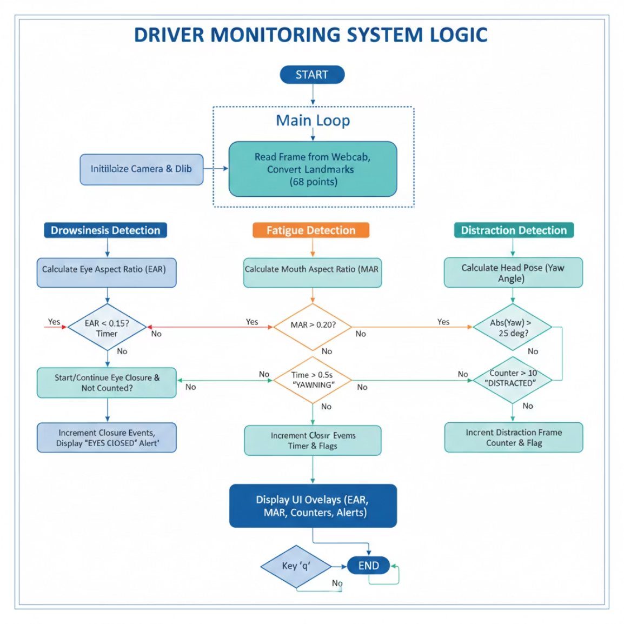

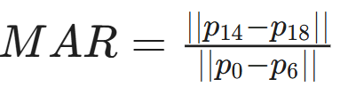

Methodology
1
2
Eye Aspect Ratio (EAR) – Drowsiness
Mouth Aspect Ratio (MAR) – Fatigue
Points Used: Indices [36-41] (Left Eye) and [42-47] (Right Eye).
Threshold: < 0.15 for > 0.5s triggers "EYES CLOSED" alert.
Points Used: Inner lip indices [62, 66] for height and [48, 54] for width.
Threshold: > 0.20 for > 0.5s triggers "YAWNING" event.
3
Head Pose Estimation (Yaw) – Distraction
Utilises SolvePnP to map 2D landmarks to a 3D head model, identifying head turns away from the road.
Points Used: Nose tip [30], Chin [8], Eye corners [36, 45], Mouth corners [48, 54].
Threshold: Absolute Yaw > 25° for > 10 frames triggers "DISTRACTED" alert.
Notes:
2

Slide 3
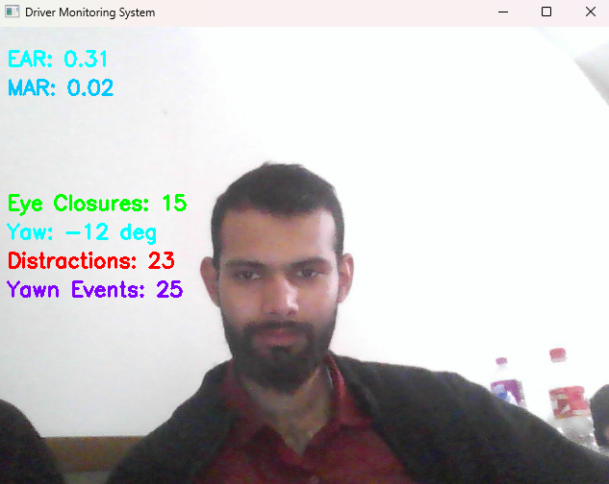





Results & Accuracy Analysis
Drowsiness
94%
EAR < 0.15 for > 0.5s
Fatigue (Yawn)
91%
MAR > 0.20 for > 0.5s
Distraction
88%
Head Yaw > 25° for 10+ frames
Future Scope & Enhancements
Night Vision Capability
Edge Computing Deployment
Gaze Tracking
Integrating Infrared (IR) sensors will enable the system to function reliably in low-light and nighttime driving conditions, addressing a critical safety gap.
Optimising the model for embedded hardware, like Raspberry Pi or NVIDIA Jetson, will enable standalone, in-car operation without external processing power.
Enhancing distraction detection by tracking precise pupil movement, rather than just head orientation, will provide more granular insights into driver attention.
Haptic & Audio Alerts
Personalised Calibration
Connecting the detection logic to in-car hardware will allow for immediate, localised alerts through steering wheel vibrations or targeted audio warnings.
Implementing AI to learn each driver's unique baseline eye and mouth aspect ratios will significantly reduce false positives, adapting to individual facial structures.
Stable Frame Rate
Low Latency Alerts
The system consistently maintains a stable 25–30 FPS on standard CPU hardware, guaranteeing smooth and continuous monitoring without requiring specialised hardware.
With a remarkably low latency of less than 150 milliseconds, the system provides immediate driver alerts, enabling timely intervention and significantly enhancing road safety.
Notes:
3

